Slide 1
SQL: Intermediate Queries
Database Systems
Department of Computer Science, CBNU
Prof. Nasridinov Aziz (aziz@chungbuk.ac.kr)

Slide 2
In the Last Lecture
Data Definition Language (DDL)
  Notation for defining the database schema
    Used to create and modify the structure of your relations and database objects
  Statements
    CREATE
    DROP
    ALTER
    TRUNCATE

Slide 3
In the Last Lecture
MySQL constraints
  SQL constraints are used to specify rules for the data in a relation
  MySQL constraints
    NOT NULL
    PRIMARY KEY
    FOREIGN KEY
    UNIQUE
    CHECK
    DEFAULT

Slide 4
In the Last Lecture
Data Manipulation Language (DML)
  A language for searching, modifying, inserting and deleting the desired data in the database
    DML also known as query language
  Statements
    INSERT
    UPDATE
    DELETE
    SELECT

Slide 5
In the Last Lecture
The SELECT statement
  Used to select/retrieve tuples from a database
  Syntax
    SELECT [DISTINCT] attribute(s) (1)
    FROM relation(s) (2)
    [WHERE condition] (3)
    [GROUP BY attribute(s)] (4)
    [HAVING condition] (5)
    [ORDER BY attribute(s)] (6)
    [LIMIT number]; (7)
Compulsory
Optional

Slide 6
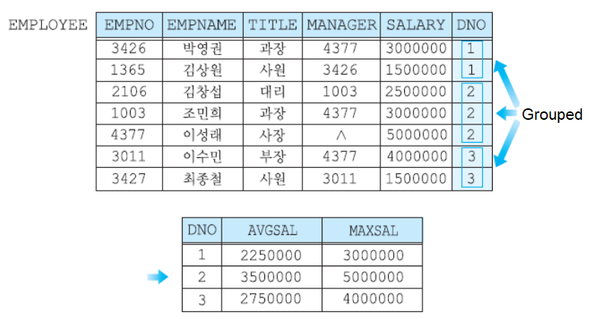
In the Last Lecture
The GROUP BY statement
  Query: Group the employees by department and calculate avg and max salaries
    SELECT dno, AVG(salary) as avgsal, MAX(salary) as maxsal
    FROM employee
    GROUP BY dno;

Slide 7
Table of Contents
Intermediate DDL
Intermediate DML
  Join queries
Summary and Discussions

Slide 8
Intermediate DDL
Part 1

Slide 9
1. Intermediate DDL
MySQL constraints
  SQL constraints are used to specify rules for the data in a relation
  MySQL constraints
    NOT NULL
    PRIMARY KEY
    FOREIGN KEY
    UNIQUE
    CHECK
    DEFAULT

Slide 10
1. Intermediate DDL
UNIQUE constraint
  Ensures that all values in an attribute are different
  UNIQUE constraint vs. PRIMARY KEY constraint
    Both the UNIQUE and PRIMARY KEY constraints provide a guarantee for uniqueness for an attribute or set of attributes
    A PRIMARY KEY constraint automatically has a UNIQUE constraint
    However, you can have many UNIQUE constraints per relation, but only one PRIMARY KEY constraint per relation

Slide 11
1. Intermediate DDL
DEFAULT constraint
  Used to set a default value for an attribute
    The default value will be added to all new tuples, if no other value is specified
CHECK constraint
  The CHECK constraint is used to limit the value range that can be placed in a column
    It will allow only certain values for this column

Slide 12
1. Intermediate DDL
Example for MySQL constraints
    CREATE TABLE employee(
    empno int NOT NULL,
    empname varchar(45),
    title varchar(45) DEFAULT '사원',
    manager int,
    salary int,
    dno int,
    CONSTRAINT PK_Employee PRIMARY KEY (empno),
    CONSTRAINT FK_Employee_Manager
    FOREIGN KEY (manager) REFERENCES employee(empno),
    CONSTRAINT FK_Department_Employee
    FOREIGN KEY (dno) REFERENCES department(deptno),
    CONSTRAINT UQ_empname UNIQUE (empname),
    CONSTRAINT CH_salary CHECK (salary < 6000000),
    CONSTRAINT CH_dno CHECK (dno IN (1, 2, 3, 4, 5, 6))
    );

Slide 13
Intermediate DML
Part 2

Slide 14
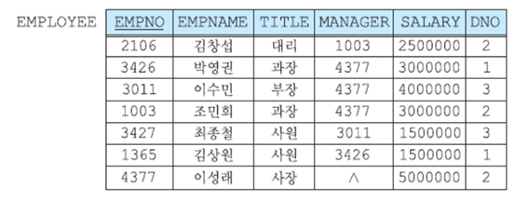
2. Intermediate DML
Join Queries
  Using the EMPLOYEE table, find the department in which the employee named '김창섭' works
  Query
    SELECT *
    FROM employee
    WHERE empname = '김창섭';

Slide 15
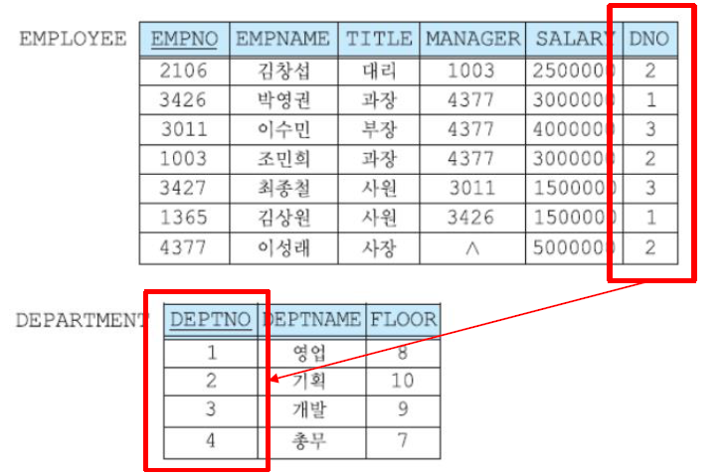
2. Intermediate DML
Join Query
  Combines tuples from two or more relations based on a common attribute

Slide 16
2. Intermediate DML
Join Query
  Syntax
    SELECT table1.column1, table2.column2
    FROM table1
    JOIN table2 ON
    table1.common_column = table2.common_column;
  Example Query
    SELECT *
    FROM employee
    JOIN department ON employee.dno = department.deptno
    WHERE empname = '김창섭';

Slide 17
2. Intermediate DML
Join Query
  How it works

Slide 18
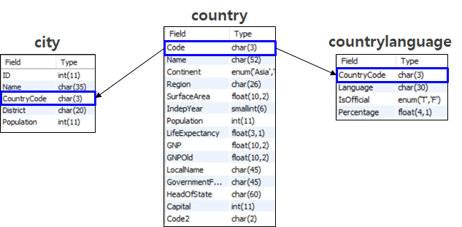
2. Intermediate DML
Join Query (Example)
  Q1: Show the countries and their cities

Slide 19
2. Intermediate DML
Join Query (Example)
  Q1: Show the countries and their cities
    SELECT CountryCode, Name
    FROM city
    ORDER BY CountryCode;
  Explanation
    You can find the countries and their cities from CITY table by simply looking through CountryCode

Slide 20
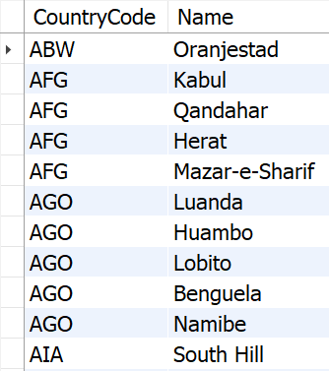
2. Intermediate DML
Join Query (Example)
  Q1: Show the countries and their cities
  Result

Slide 21
2. Intermediate DML
Join Query (Example)
  Q1: Show the countries and their cities (Better Query!)
    SELECT country.Name, city.Name
    FROM city
    JOIN country ON city.CountryCode = country.Code;
  Q1: Show the countries and their cities (EVEN Better Query!)
    SELECT C.Name, T.Name
    FROM city T
    JOIN country C ON T.CountryCode = C.Code;
  Q1: Show the countries and their cities (THE BEST!)
    SELECT C.Name AS Country_Name, T.Name AS City_Name
    FROM city T
    JOIN country C ON T.CountryCode = C.Code;

Slide 22
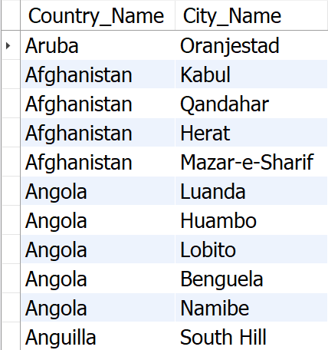
2. Intermediate DML
Join Query (Example)
  Q1: Show the countries and their cities
  Result

Slide 23
2. Intermediate DML
Join Query (Example)
  Q2: Language used in Berlin and where it is located?

Slide 24
2. Intermediate DML
Join Query (Example)
  Q2: Language used in Berlin and where it is located?
  Query
    SELECT T.Name AS City,
    C.Name AS Country,
    L.Language,
    L.Percentage
    FROM city T
    JOIN country C ON T.CountryCode = C.Code
    JOIN countrylanguage L ON C.Code = L.CountryCode
    WHERE T.Name = 'Berlin' AND L.IsOfficial = 'T';

Slide 25

2. Intermediate DML
Join Query (Example)
  Q2: Language used in Berlin and where it is located?
  Result

Slide 26
2. Intermediate DML
Other types of join queries
  (INNER) JOIN
    Returns records that have matching values in both tables
  LEFT JOIN
    Returns all records from the left table, and the matched records from the right table
  RIGHT JOIN
    Returns all records from the right table, and the matched records from the left table
  CROSS JOIN
    Returns all possible combinations

Slide 27
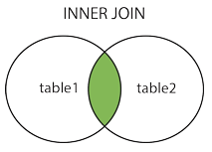
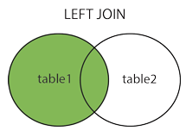
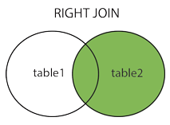
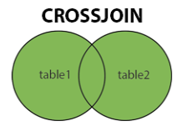
2. Intermediate DML
Other types of join queries

Slide 28
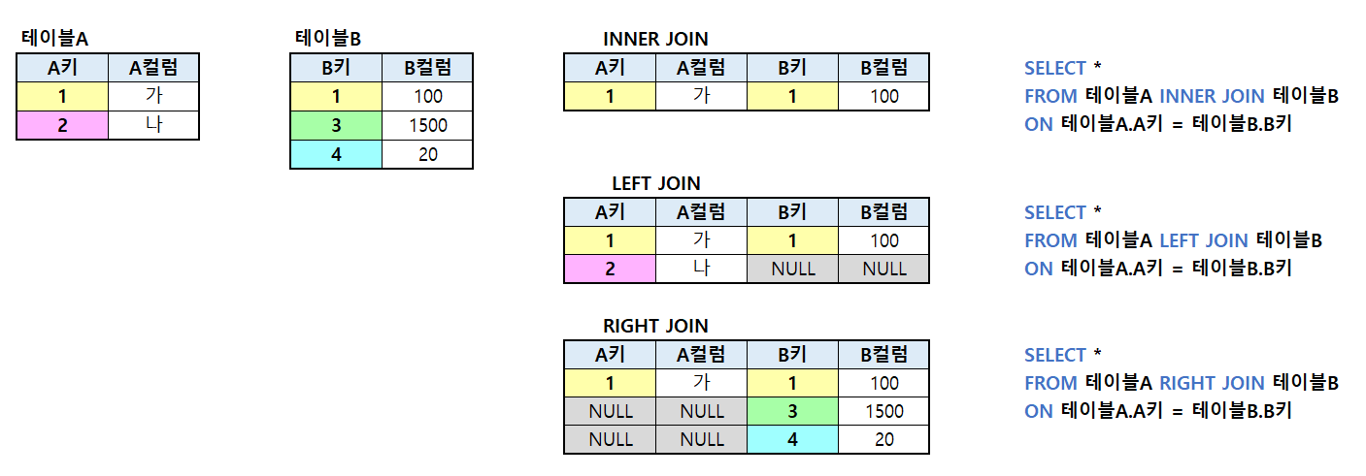
2. Intermediate DML
Other types of join queries
  Examples in Korean

Slide 29
3. Summary and Discussions
Intermediate DDL
Intermediate DML
  Join queries

